Slide 1
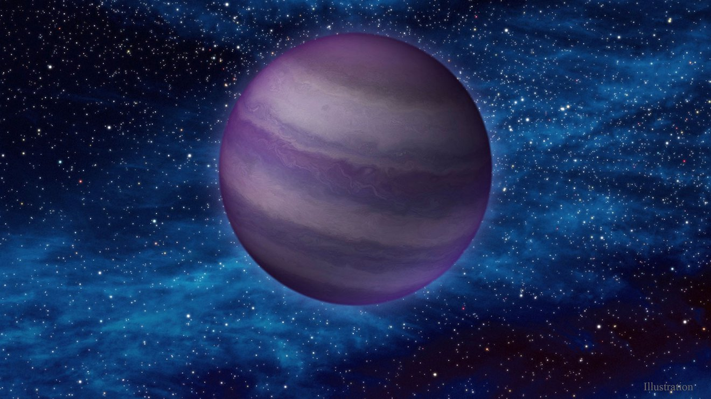
A Nearby Potentially Young and Low Mass Y Dwarf
Undergraduate Research Presentation of A Recently Discovered Y-class Brown Dwarf, CWISE J1055.12+544328.3, that has been approved for JWST Observation
By Grady Robbins and the Backyard Worlds Team
Image credit: IPAC/Caltech
Notes:
General Slide takeaways:
My name is Grady Robbins, an undergraduate astrophysics major at the University of Florida. I am currently in my senior year, and I am ecstatic to share the research I performed this Summer during my internship at NSF’s NOIRLab!
This presentation discusses the results of ApJ-accepted paper CWISE J105512.11+544328.3: A Nearby Y Dwarf Spectroscopically Confirmed with Keck/NIRES.
This image is an artist’s rendering of brown dwarf WISEA J1534-1043, otherwise known as the accident, which is an ultracool brown dwarf recently discovered
Image: https://www.space.com/the-accident-brown-dwarf-discovery-citizen-scientist

Slide 2

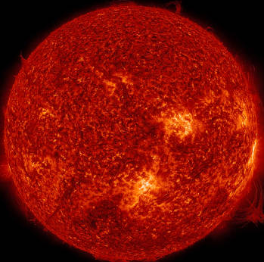
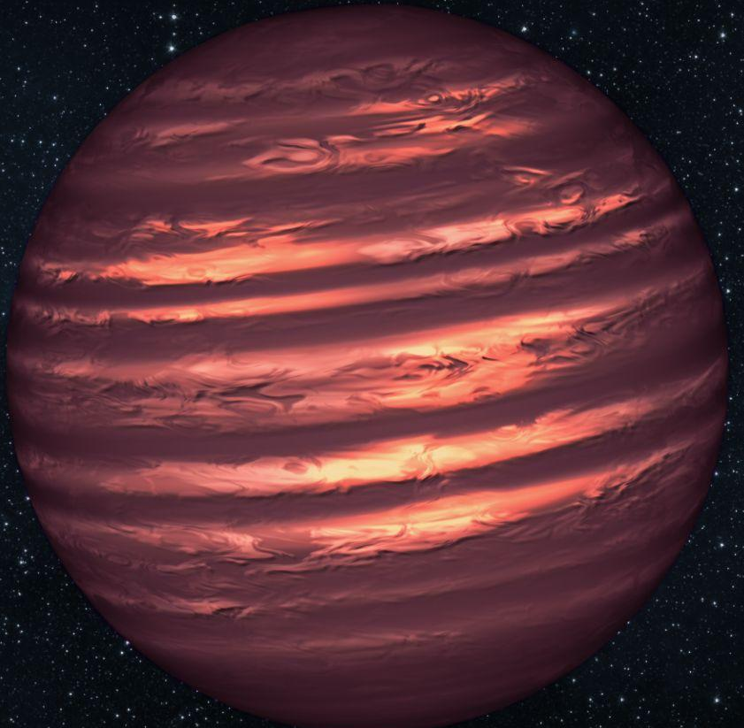
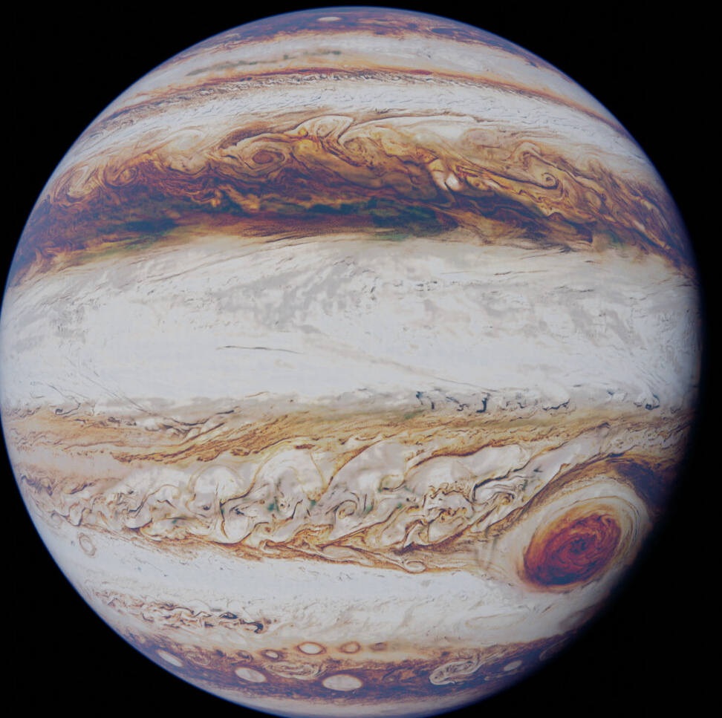
What is a brown dwarf?
Gas Giant
Brown Dwarf
Red Dwarf Star
Image credit: freepik,blenderartists, NASA/JPL, StockByM
Notes:
Talk about temperature ranges, deuterium fusing and exact differences between a gas giant and red dwarf
How do brown dwarfs form, and why are they so different in their own classes? Still not certain, but the primary two are collapse of molecular cloud (star) or exoplanet ejection. This can contribute to differences, along with metallicity, cloud makeup, viewing angle. Look at our own planet diversity!
Image: https://www.freepik.com/free-photos-vectors/space-stars , https://en.wikipedia.org/wiki/Brown_dwarf#/media/File:Artist%E2%80%99s_conception_of_a_brown_dwarf_like_2MASSJ22282889-431026.jpg,

Slide 3

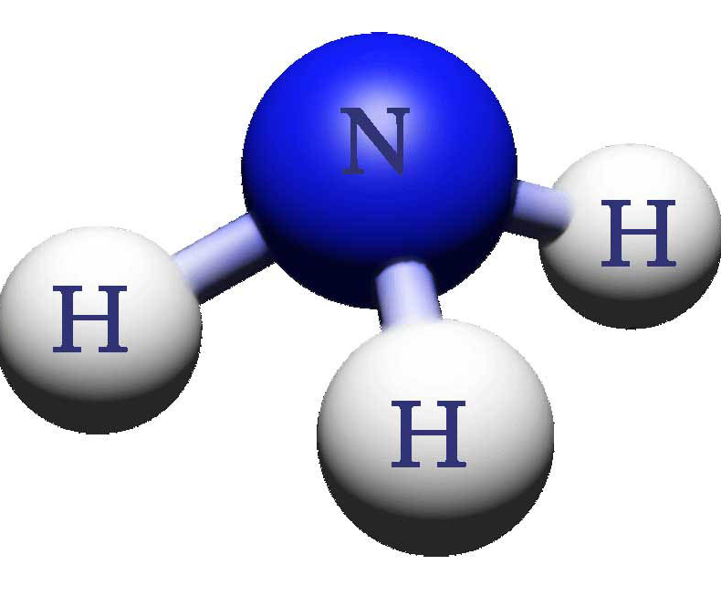
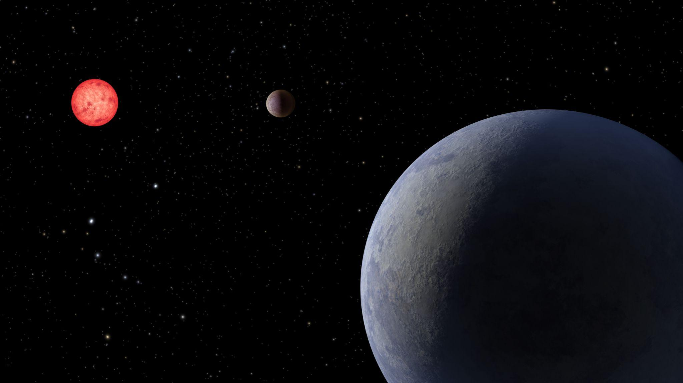
Why is it important to study brown dwarfs?
They contain important molecules associated with the formation of life
They often have no contaminating host star (unlike exoplanet systems)
They can help us learn about exoplanet atmospheres, astrobiology, and star formation
Image credit: IPAC/Caltech, flaticon
Notes:
Brown dwarfs are cooler than stars, and because of this they can contain ammonia, methane, and even water molecules (which are crucial molecules in the formation of life)! Normal exoplanets have a bright host star, making it very difficult to observe their atmospheres. However, because brown dwarfs form the way stars do, they usually don’t have any other stellar companions (meaning the light they emit has little contamination) unlike their exoplanet counterparts. Brown dwarfs are intriguing objects of study because of this, and can help gain insight into exoplanet atmospheres, the detection of life, and the prevalence of early-star material within our galaxy.
CH4, NH3, H20 in the formation of life
No bright source contamination
Brown dwarf atmospheres and how that applies to exoplanet atmospheres (especially Y dwarfs)
Star formation and how brown dwarfs form in the same way stars do, emitting much less visible light but still infrared due to deuterium
Image: https://www.flaticon.com/free-icon/ch4_5824543 (flaticon)
https://exoplanets.nasa.gov/resources/2341/super-earth-lp-890-9-c-illustration/

Slide 4
CWISE J1055+5443
(hereafter W1055)

Slide 5
Discovery and Observation
DISCOVERY
First a galaxy or dwarf candidate (Griffith et al. 2012).
Later confirmed as a brown dwarf within 10 pc (Kirkpatrick 2021; Kuchner 2017).
OBSERVATION
Spectrum observed in the near-infrared by the Keck II Telescope in 2021.
Notes:
Later confirmed as a brown dwarf within 10 parsecs based on astrometry.
Observed by the keck II NIRES telescope between 0.94 - 2.45 micrometers

Slide 6
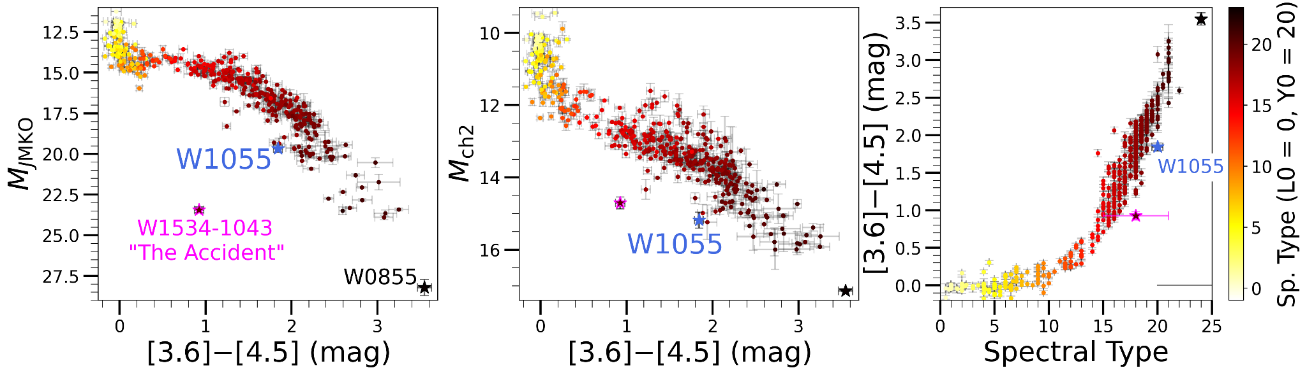
Blue Spitzer Photometry
Compared to other confirmed Y dwarfs, W1055 has an extremely blue [3.6]-[4.5] color of 1.84 ± 0.04 mags!
Notes:
Explain various detections of J, ch1, ch2. This data made our object initially classified as a T8 dwarf due to the blue color. Once we found out how nearby it was, the color more aligned with that of a Y dwarf

Slide 7
We Can Use the Spectrum to Determine Spectral Type
L
T
Y
Hottest spectral type (2100 K < T < 1300 K)
Atmospheres rich with various molecules
1300 K < T < 700 K
Extremely methane rich
Coolest spectral type (T < 500 K)
Least-studied brown dwarf
Notes:
visualization of all types, and what they mean, how we got there.
What spectral type is W1055?

Slide 8
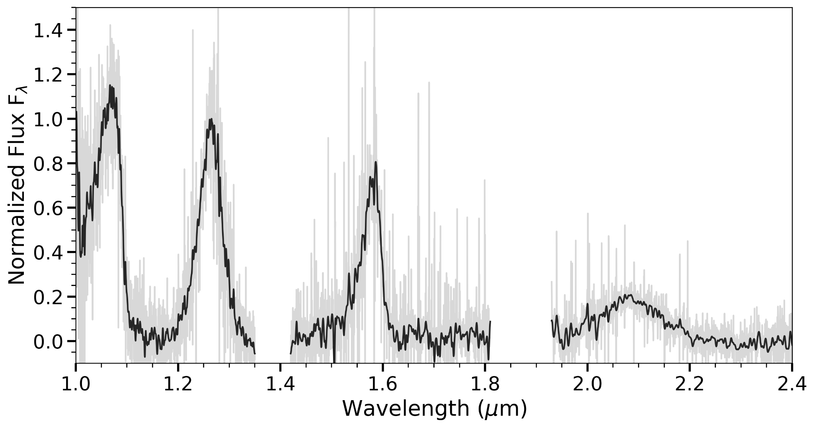
Near-infrared spectrum of W1055
Y
J
H
K

Slide 9
We Can Use the Spectrum to Determine Spectral Type
L
T
Y
Hottest spectral type (2100 K < T < 1300 K)
1300 K < T < 700 K
Coolest spectral type (T < 500 K)
Notes:
visualization of all types, and what they mean, how we got there.
What spectral type is W1055?

Slide 10
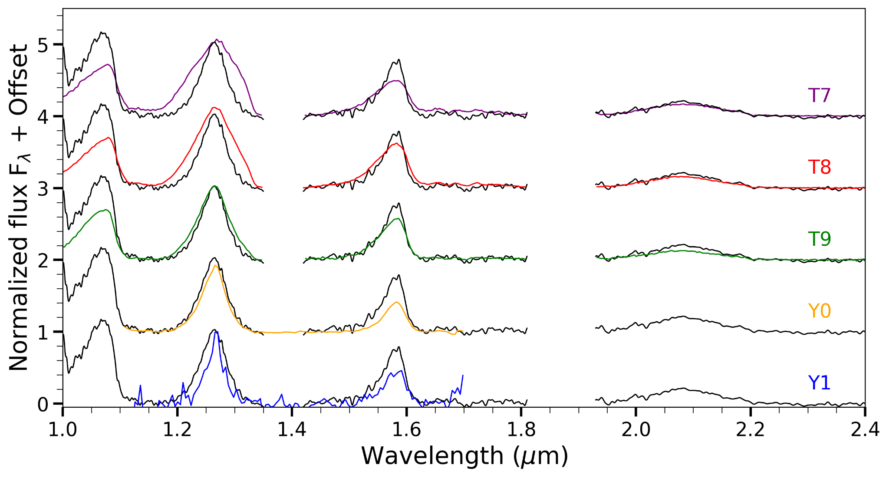
What Spectral Type is W1055?
W1055
We assign W1055 a tentative spectral type of Y0
Y0 Fits Best!

Slide 11
Molecular Absorption in W1055’s Spectrum
NH3
H2O
H2O
H2O
CH4
CH4
CH4
CH4
Near-infrared spectrum of W1055
Y
J
H
K

Slide 12
NH3
Supports a Y0 classification
H2O
H2O
H2O
Supports a >T8 classification
CH4
CH4
CH4
Supports a Y0 classification
CH4
Corresponding spectral types are from Cushing et al. (2011) and Kirkpatrick et al. (2012)
Y
J
H
K
Notes:
Why is the J band seen as the most important in classifying brown dwarfs? And not all bands overall?

Slide 13
Physical Properties
of W1055

Slide 14
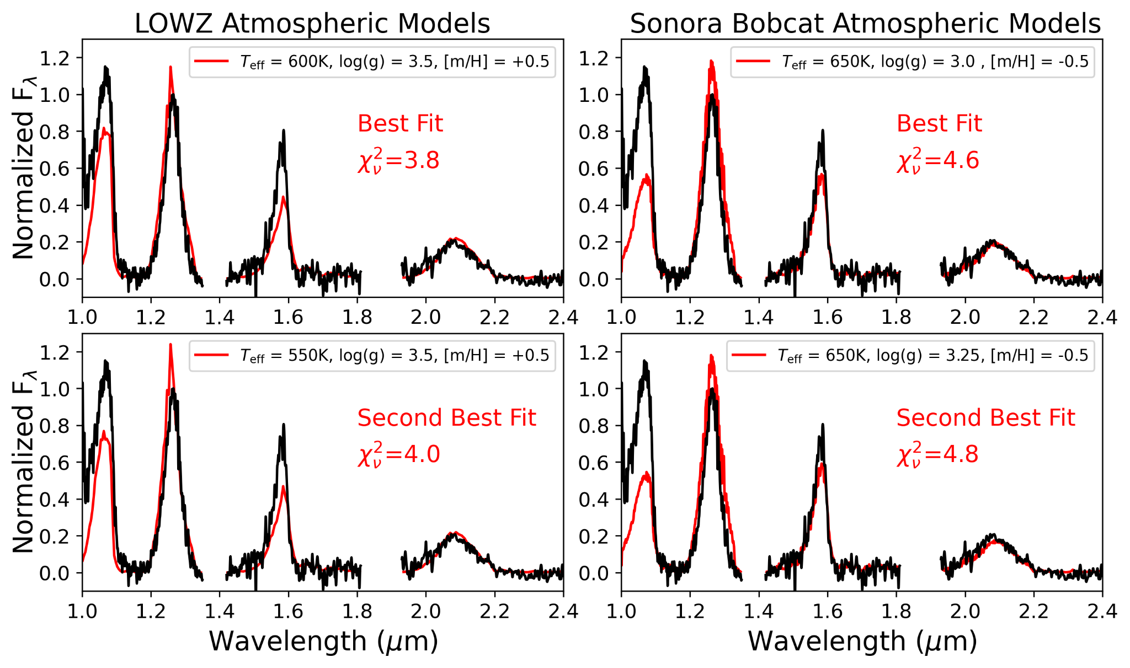
Atmospheric Modeling is Unclear
Notes:
We used two up-to-date atmospheric models, LOWZ and Sonora Bobcat
Models have temperature, gravity, and metallicity as variable parameters, producing estimated resulting spectra
Models were compared to W1055 using a chi-squared best-fit metric (lower values correspond to a better fit)
No model produced a good fit for W1055, but all models pointed to a lower gravity type (and therefore younger age)

Slide 15
Uncertain Temperature
Atmospheric models point to temperatures of 550 K - 650 K
Using polynomial relations (Kirkpatrick et al. 2019,2021) based on absolute magnitudes and colors:
  We calculated a large range of temperatures between ~400 K and ~650 K due to the anomalous photometry of W1055
Because of this, we estimate an uncertain temperature of 500 K +/- 150 K
Notes:
Atmospheric models pointed to slightly higher temperatures for a Y0 dwarf (550 K - 650 K)
We use polynomial relations from Kirkpatrick et al. (2019,2021), which allow us to obtain temperature estimates from absolute magnitudes and colors
We estimated a range of temperatures between ~400 K and ~650 K due to the strange photometry of W1055
Because of this, we estimate an uncertain temperature of 500 K +- 150 K

Slide 16
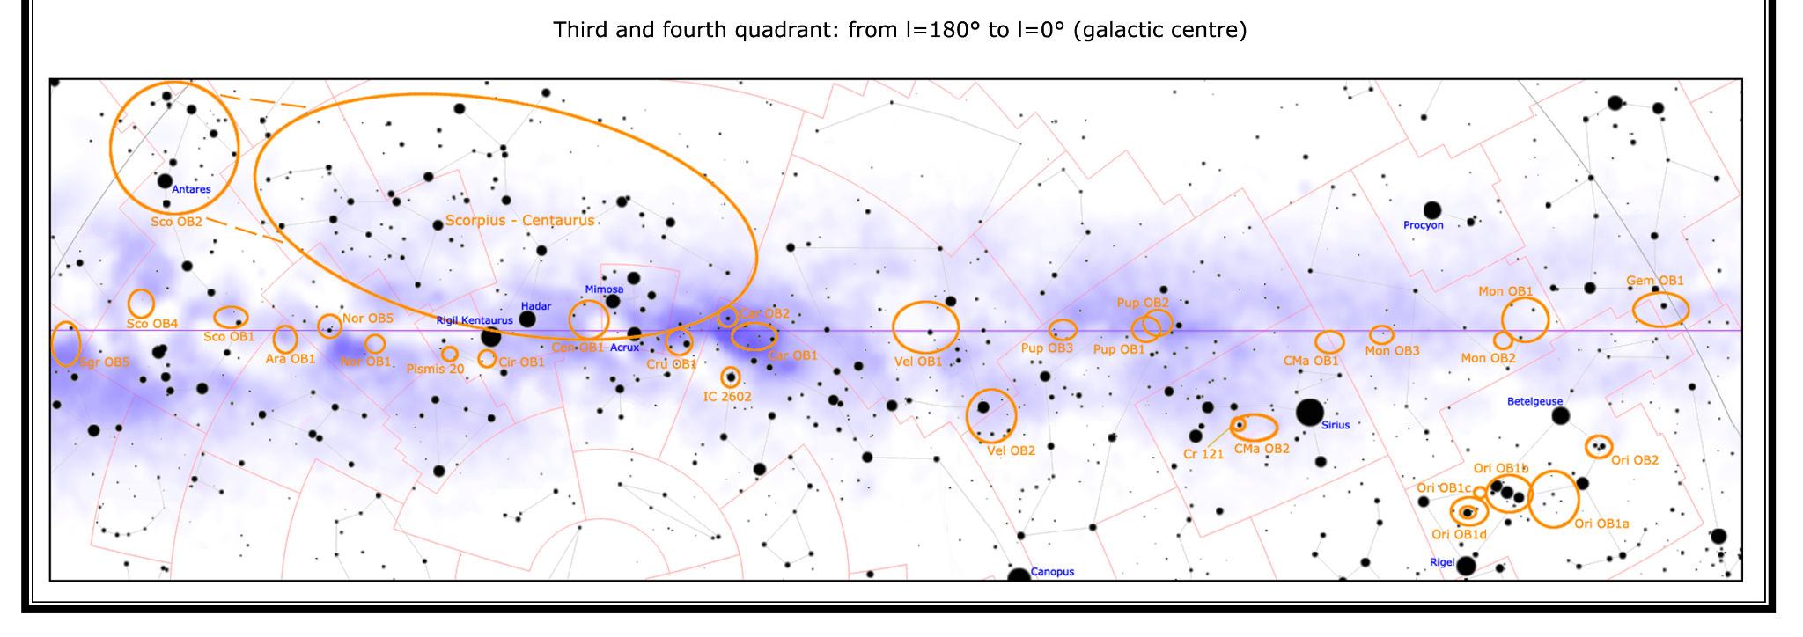
Age Estimates are Very Young!
Using the BANYAN Σ model which estimates an object’s moving group (and therefore probable age) based on kinematics:
  We find a 98.2% probability in the Crius 197 association from W1055’s parallax, which would indicate an age of 180 +/- 9 Myr
We would need JWST to observe W1055’s radial velocity, which would conclusively test if W1055 is in Crius 197.
Image credit: Perseus
Notes:
Using the BANYAN Sigma models which estimate an object’s moving group (and therefore probable age) based on kinematics:
We find a 98.2% probability in the Crius 197 association, which would indicate an age of 180 +- 9 Myr based on rotational periods***
We would need JWST to observe W1055’s radial velocity due to faintness, which would confirm a YMG for W1055.
The age probability is based on rotation periods, and 2 of the 10 members in the group were older (600my 1by) and this could mean they are chance interlopers or heterogenous group
Include image of moving group associations for support
Would this make w1055 the youngest y dwarf?

Slide 17

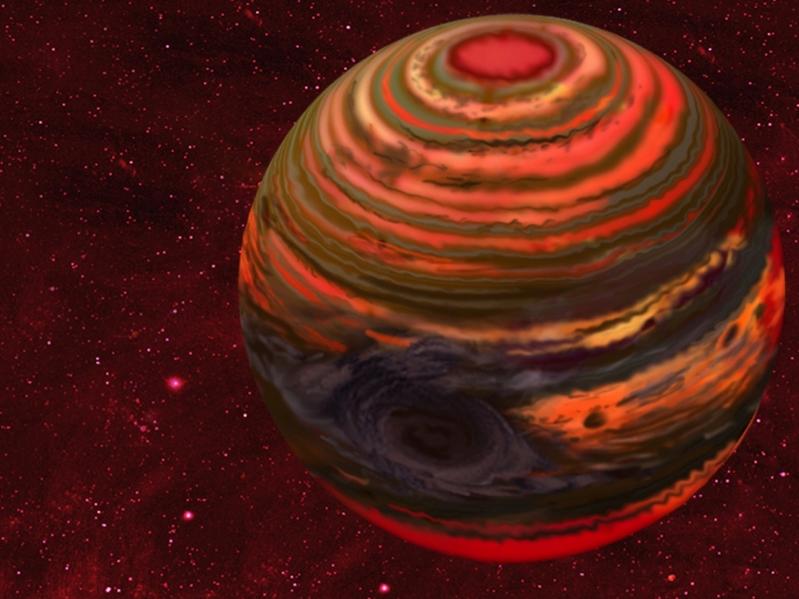
Finally, the Mass!
Using our previous age estimate of ~180 Myr and an estimated log(L_{bol}/L_{Sun}) ~ -6.0 from its spectral energy distributions:
  We estimate a mass of 4-6 Jupiter masses, which is well within the planetary mass regime (Filippazzo et al. 2015.)
Artist’s rendition of an active brown dwarf with storms
Notes:
Using our previous age estimate of ~180 Myr and an estimated log luminosity scale of ~-6.0 (meaning the brown dwarf is 1 million times less luminous than teh sun:
We estimate a mass of 4-6 Jupiter masses, which is well within the planetary mass regime.
Can include an image of a small brown dwarf
Would this make W1055 the lowest mass brown dwarf? I thought brown dwarfs couldn’t be smaller than ~13 Jupiter masses?

Slide 18
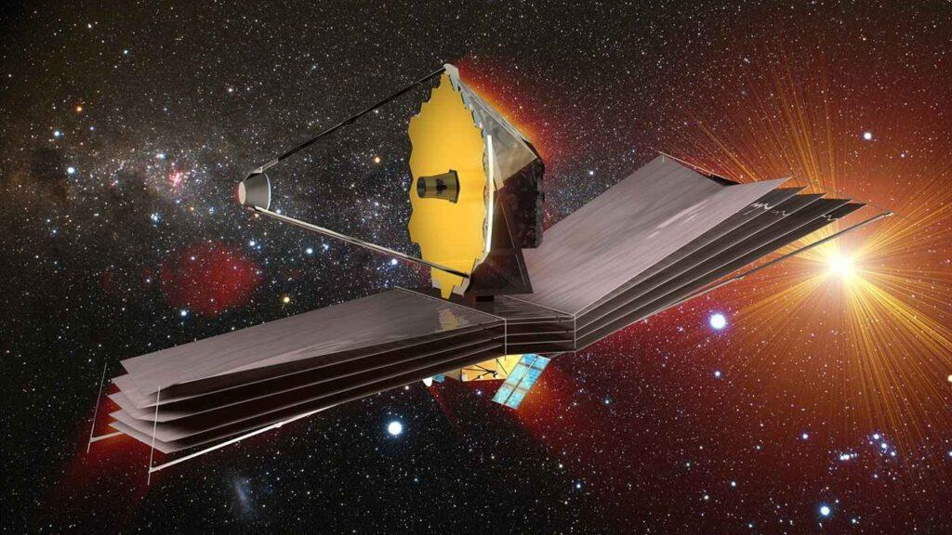
Conclusion & JWST Follow Up
We spectroscopically confirmed W1055 as a Y0 (pec) brown dwarf with an estimated T = 500 +-150 K, an age of ~180 +/- 9 Myr, and an estimated mass of 4-6 MJup.
W1055 adds to the growing diversity of Y dwarfs, and may be the first “young” Y dwarf.
JWST spectroscopy and radial velocity observation will give an accurate classification in 2024-2025!
Image credit: ESA
Notes:
We spectroscopically confirm W1055 as a Y0 (pec) brown dwarf with an estimated T = 500 +-150 K, an age of ~180 +- 9 Myr, and an estimated mass of 4-6 M(jupiters).
These estimates can be greatly approved upon through JWST observation of radial velocity and low-resolution spectroscopy spanning the entire 0.6-5 micron wavelength.
JWST approved for low-res spectroscopy, NIR spectroscopy, and MIRI imaging

Slide 19


Acknowledgments
I thank Dr. Aaron Meisner and the Backyard Worlds Team for their assistance in preparing this presentation.
Contact Me!
grobbins1@ufl.edu
Approved JWST Cycle 3 Proposal
ApJ Published Paper
Image credit: IPAC/Caltech
Notes:
General Slide takeaways:
I am Grady Robbins, an undergraduate astrophysics major at the University of Florida. I am currently in my senior year, and I am ecstatic to share the research I performed this Summer during my internship at NSF’s NOIRLab!
This presentation discusses the results of ApJ-accepted paper CWISE J105512.11+544328.3: A Nearby Y Dwarf Spectroscopically Confirmed with Keck/NIRES.
This image is an artist’s rendering of brown dwarf WISEA J1534-1043, otherwise known as the accident, which is an ultracool brown dwarf recently discovered
Image: https://www.space.com/the-accident-brown-dwarf-discovery-citizen-scientist

